Slide 1
Custom Bootcamp Week-2
Shivam Jindal
Shivam.Jindal@shell.com

Slide 2
Azure Storage Types
Azure Blob Storage: Ideal for storing unstructured data like images, documents, and videos.
Azure File Storage: Provides fully managed file shares in the cloud, suitable for legacy applications and easy file sharing across Windows and Linux.
Azure Table Storage: A NoSQL data store for semi-structured data, best suited for fast, simple queries on large datasets.
Azure Queue Storage: Offers a messaging solution for building scalable, distributed, and loosely coupled applications.

Slide 3
Azure Blob Storage Gen1 vs Gen2
Azure Blob Storage - Generation 1
The original Azure Blob Storage version.
Ideal for basic storage needs.
Page Blobs for virtual machine disks.
Limited access tiers (Hot and Cool).
Access control via keys or SAS.
Azure Blob Storage - Generation 2
Enhanced and modernized Azure Blob Storage.
Enhanced and modernized Azure Blob Storage.
Hierarchical namespace for structured data.
Multiple access tiers (Hot, Cool, Archive).
Improved analytics and data management.

Slide 4
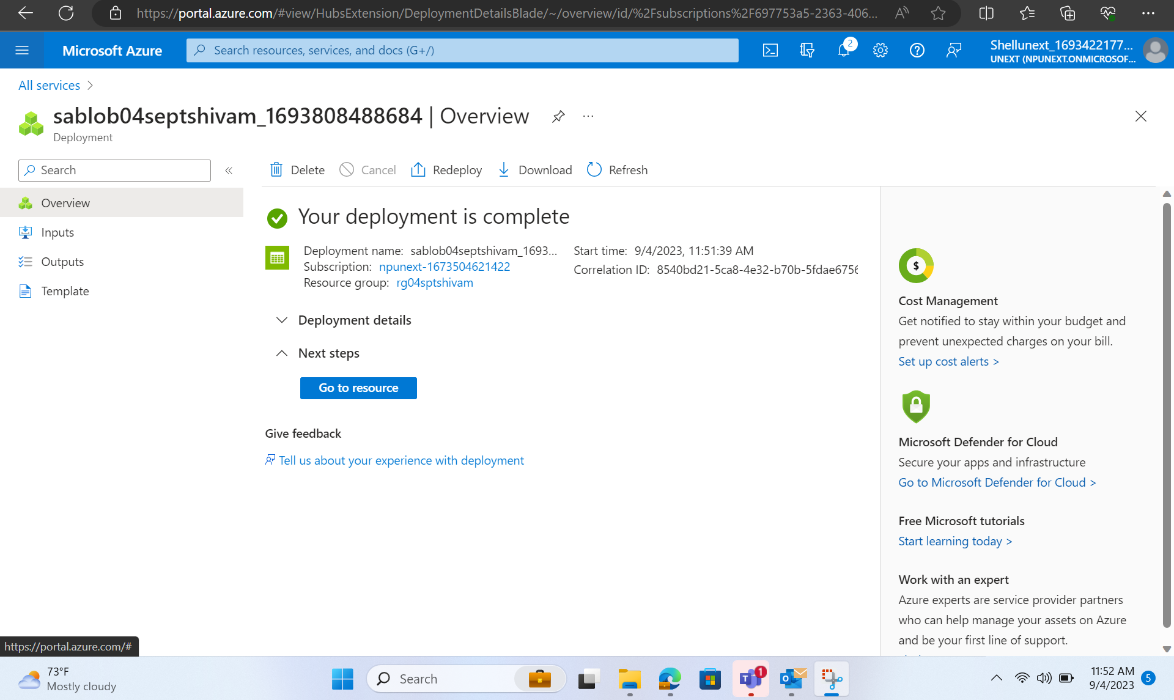
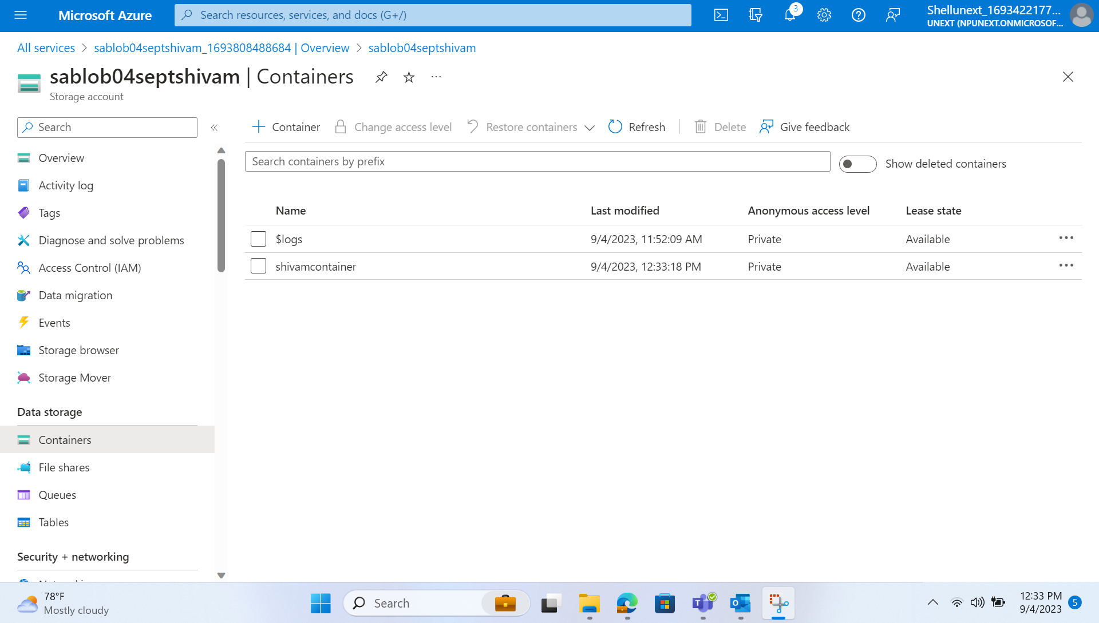
Creating Storage Account and Containers in Azure

Slide 5
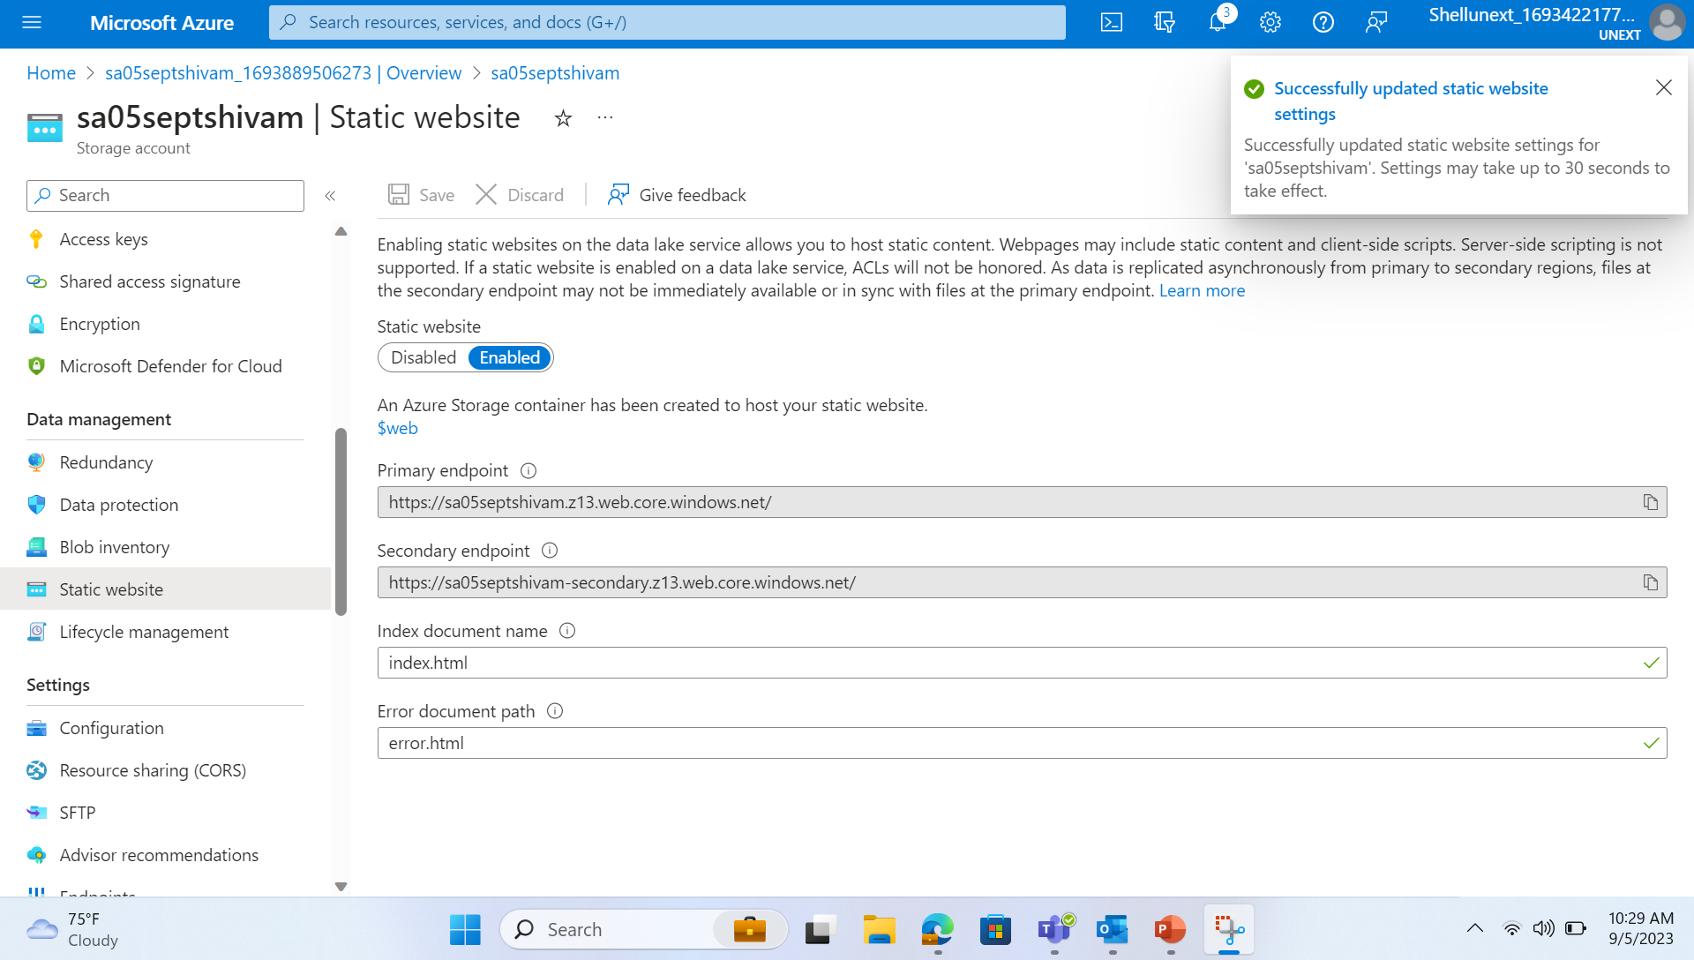
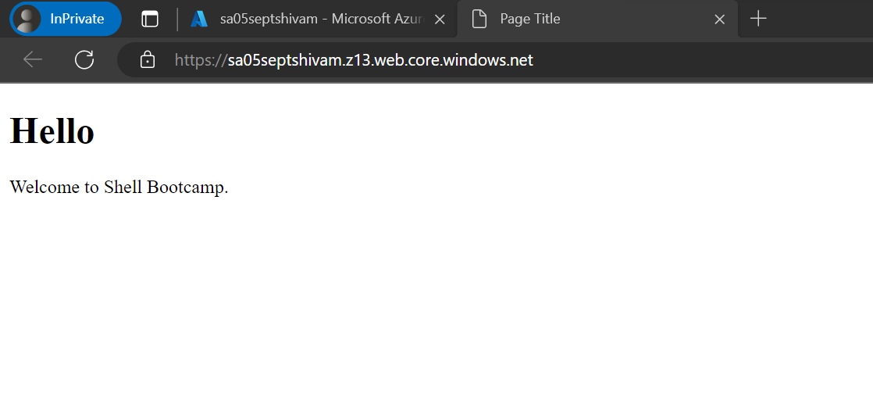
Hosting a Static Website

Slide 6
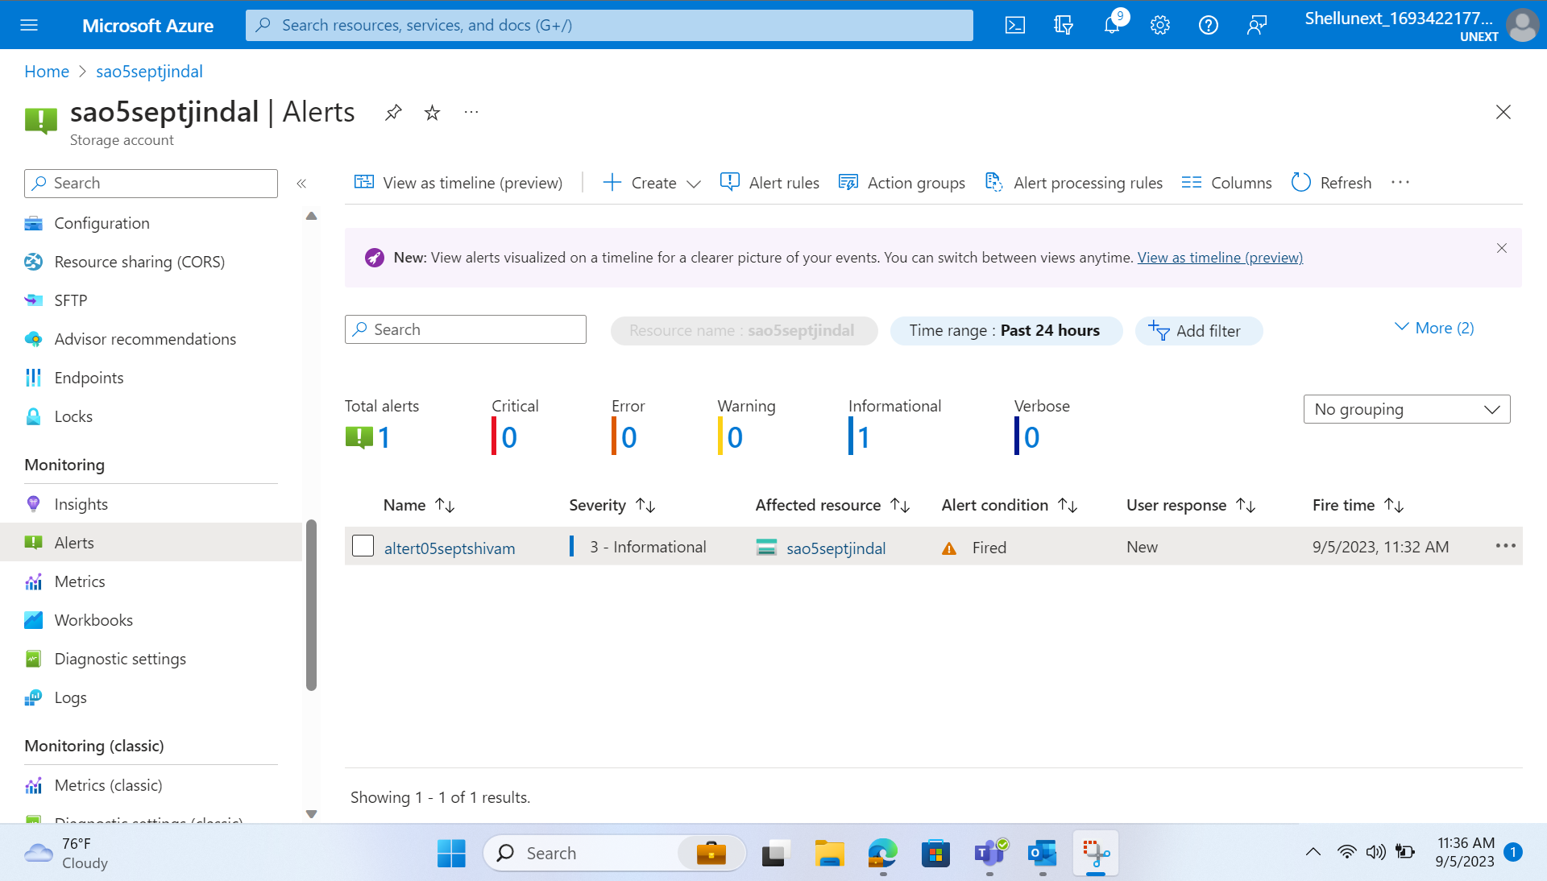
Alerts

Slide 7
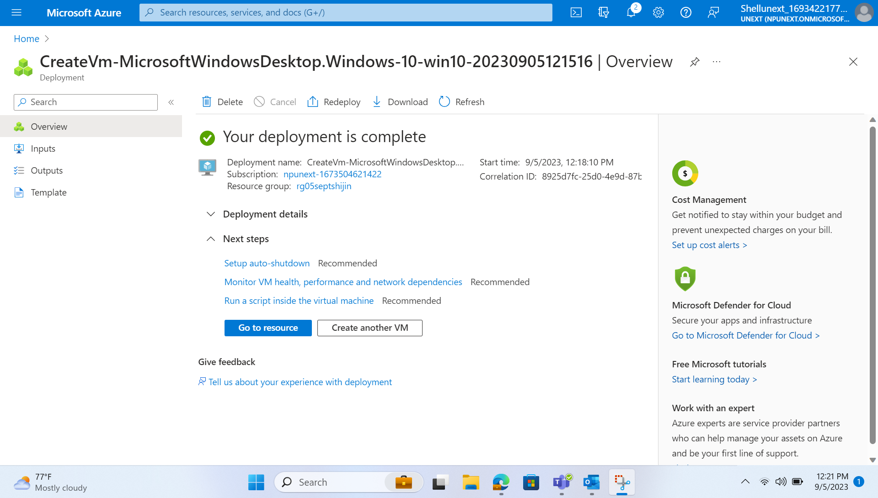
Creating a Virtual Machine

Slide 8
Azure Data Factory
Cloud-based Data Integration Service
Orchestration of Data Workflows
Connects to Diverse Data Sources
Transforms and Moves Data Effortlessly
Supports Dynamic Pipelines
Handles ETL and ELT Processes
Ensures Security and Compliance
Enables CI/CD with Azure DevOps
Tracks Data Lineage and Impact
Supports Templates and Automation

Slide 9
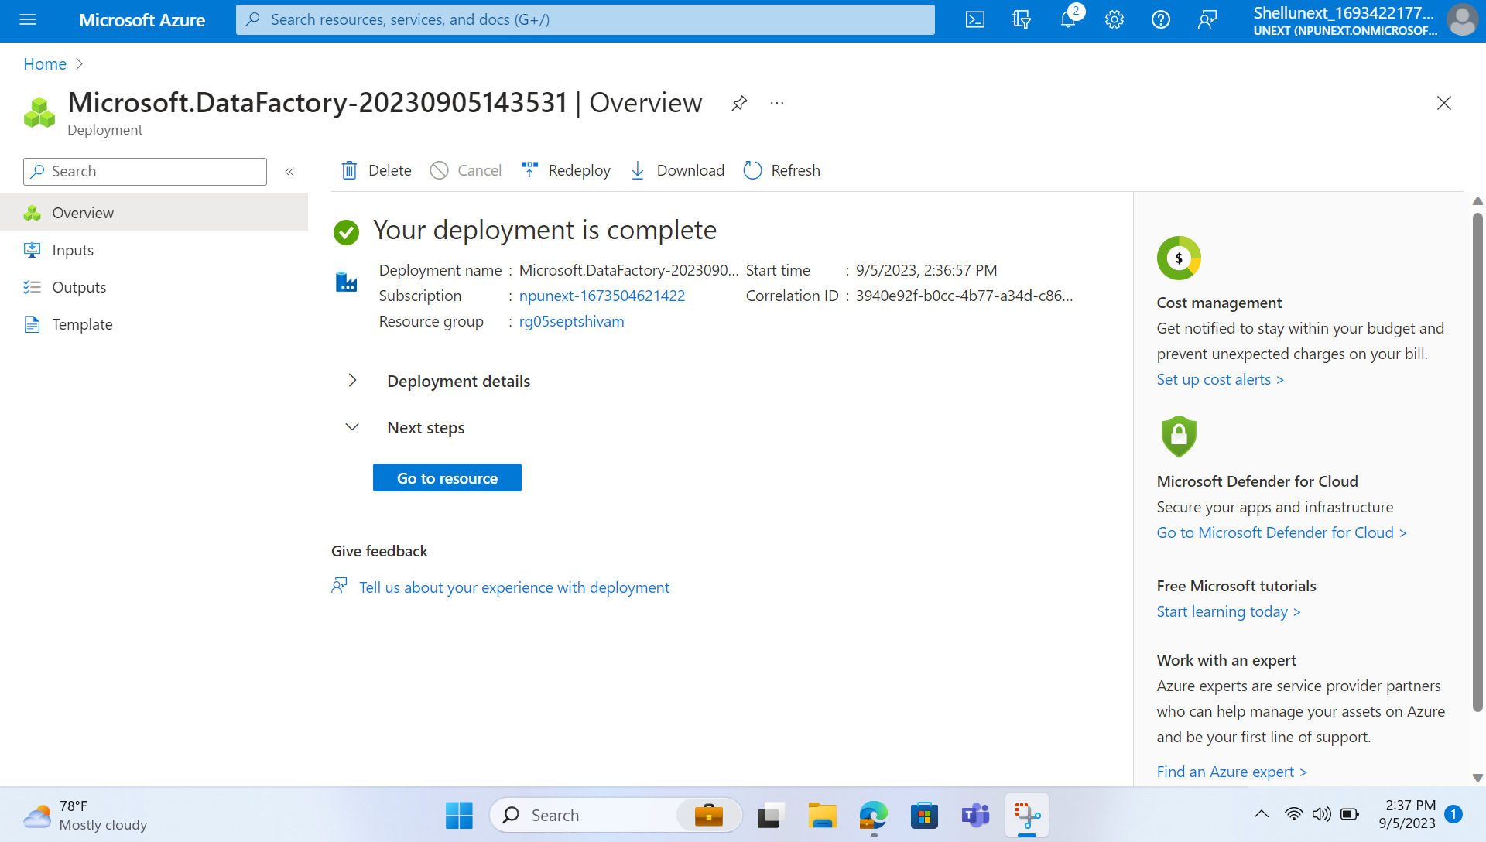
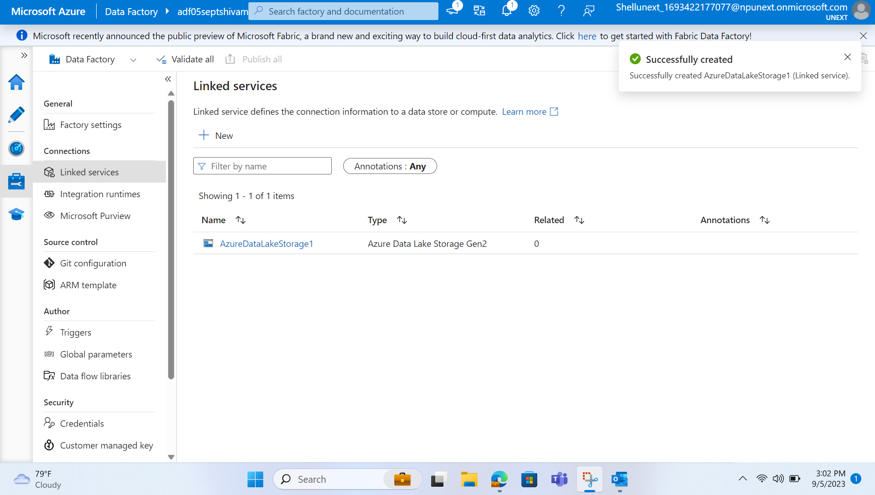
Deploying and Working Azure Data Factory

Slide 10
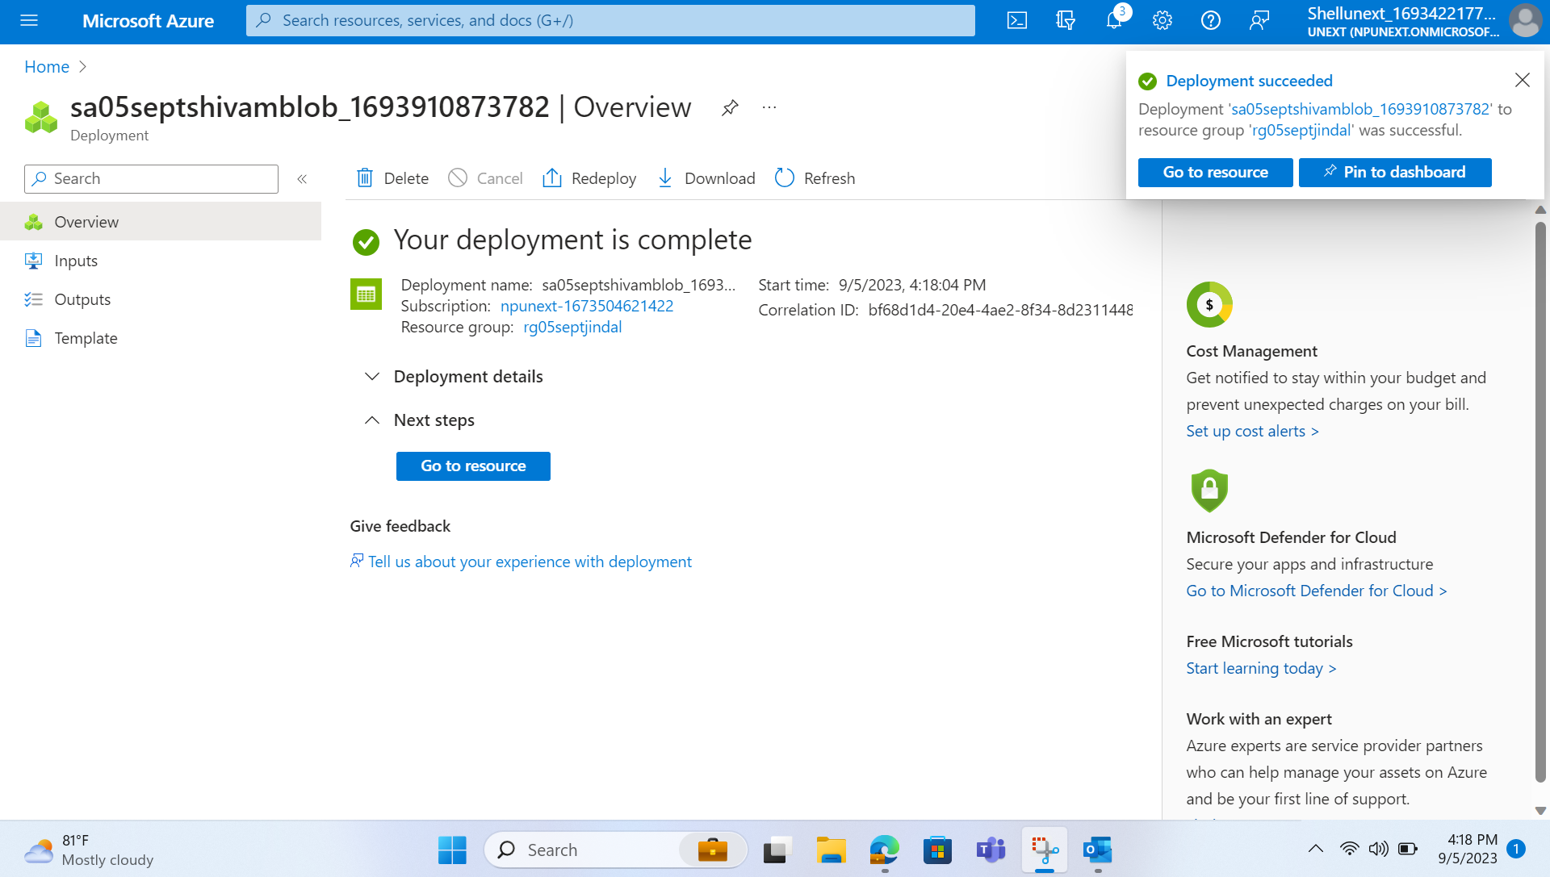

Copying Data from Blob to Gen2
Creating Storage Account for Blob
Creating Storage Account for Gen2
Then, Creating a Pipeline

Slide 11
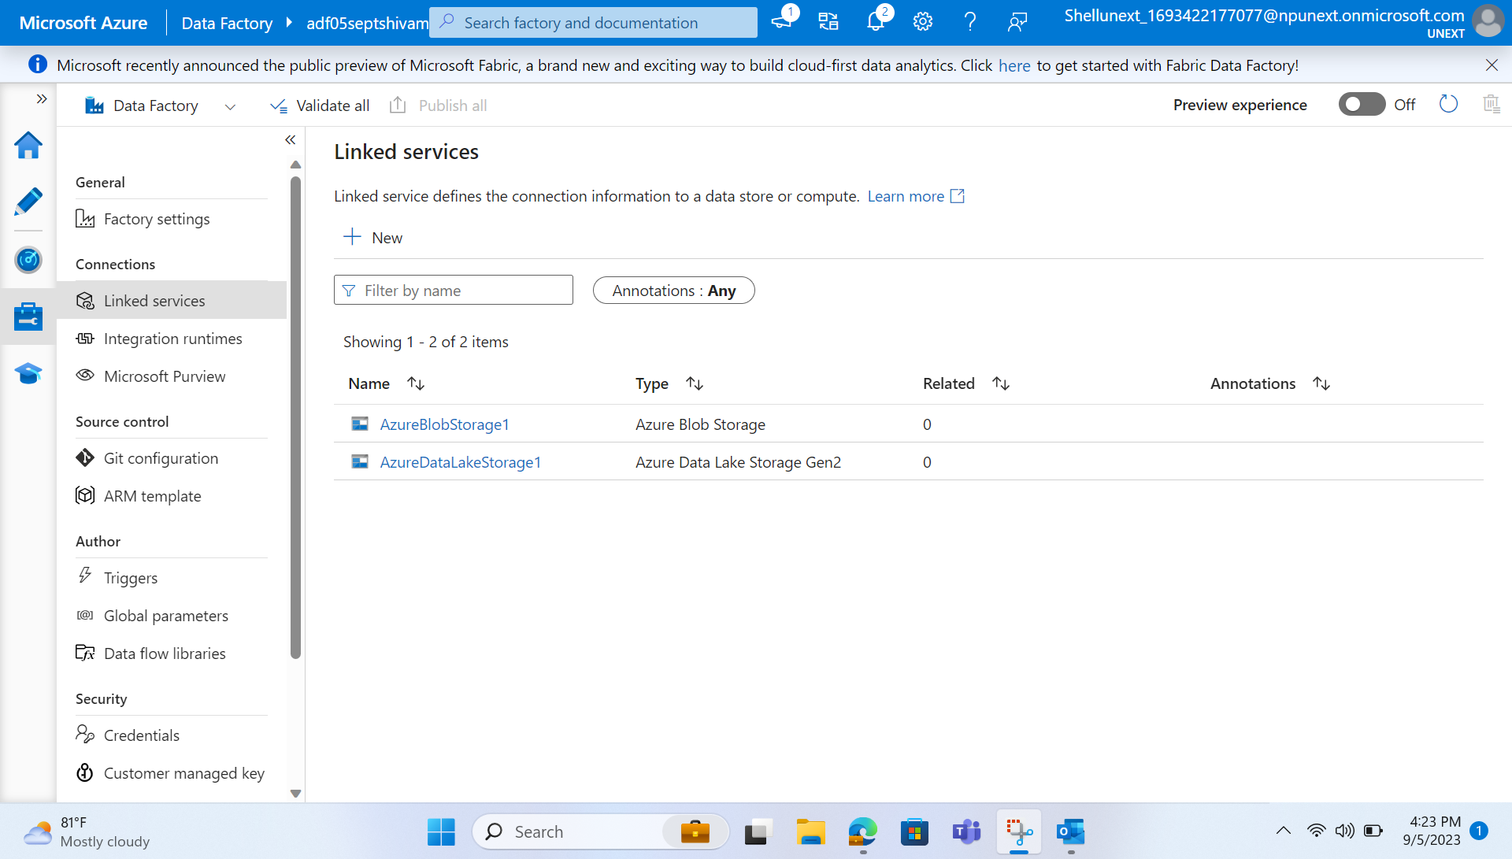
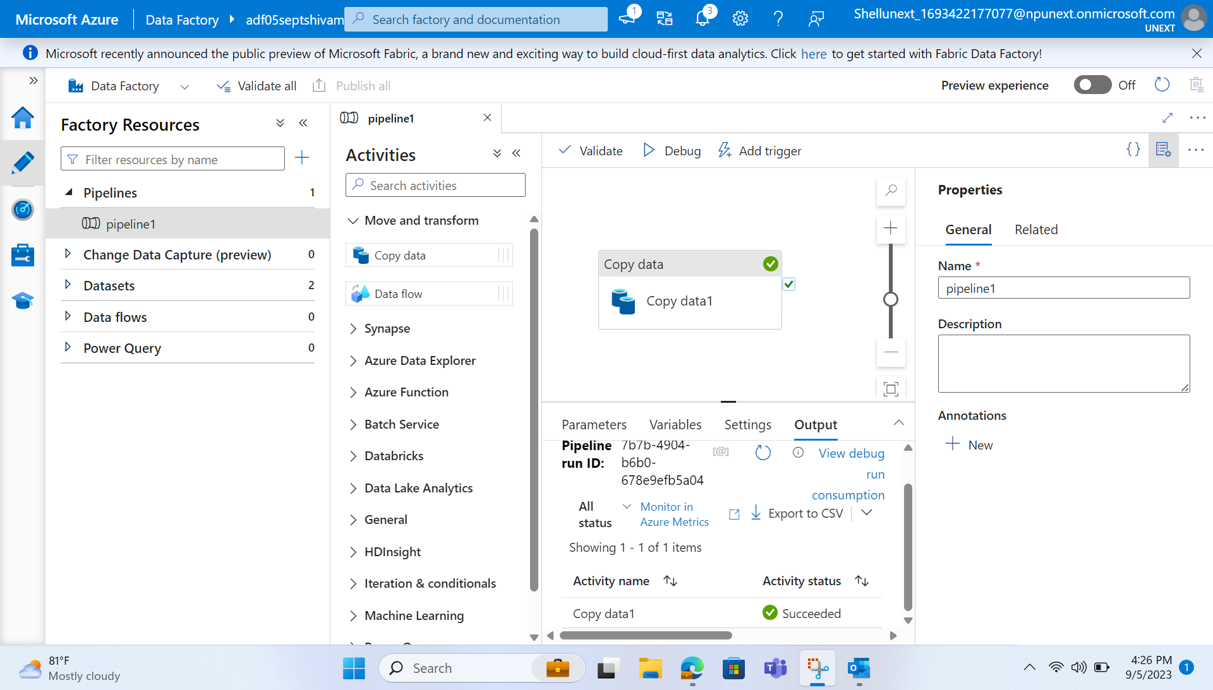

Slide 12
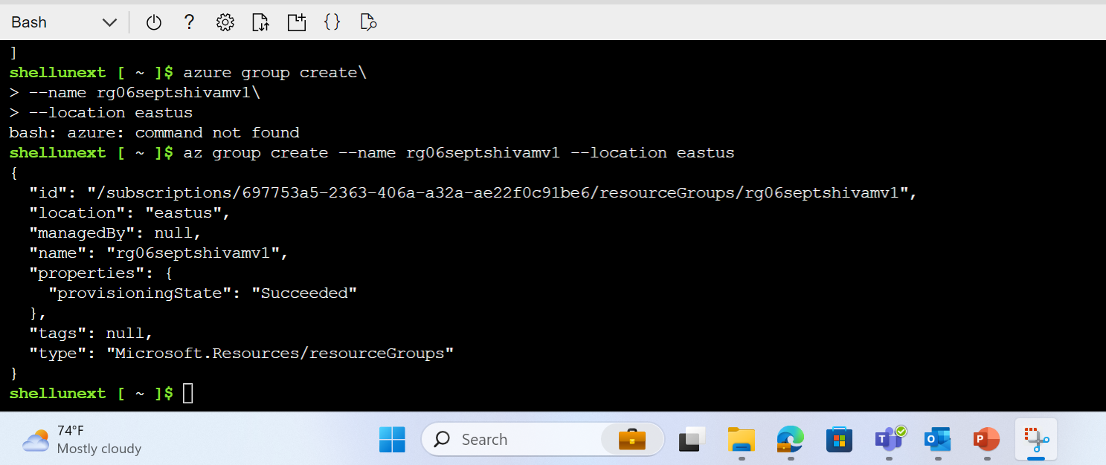
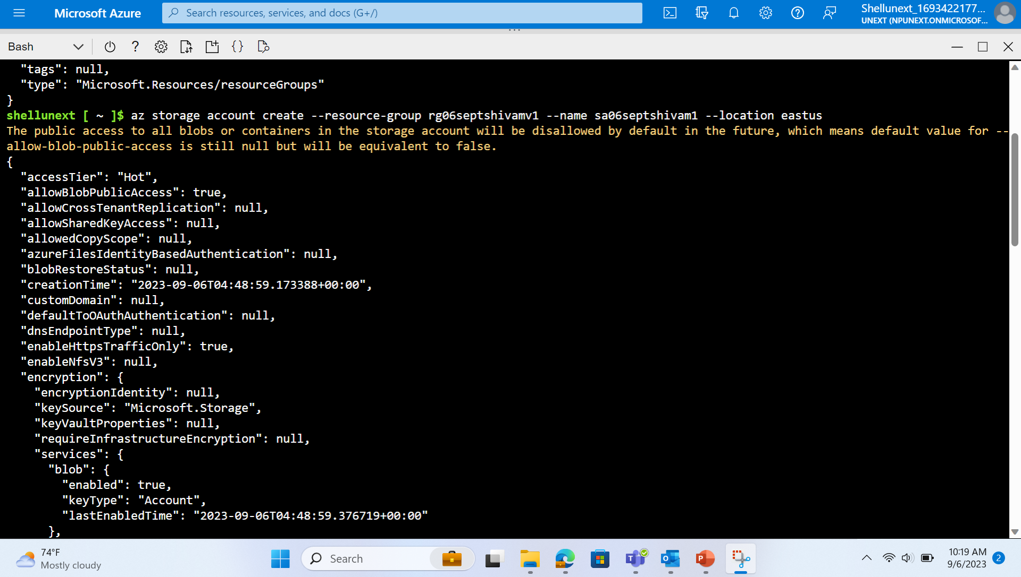
Working with Azure using CLI

Slide 13
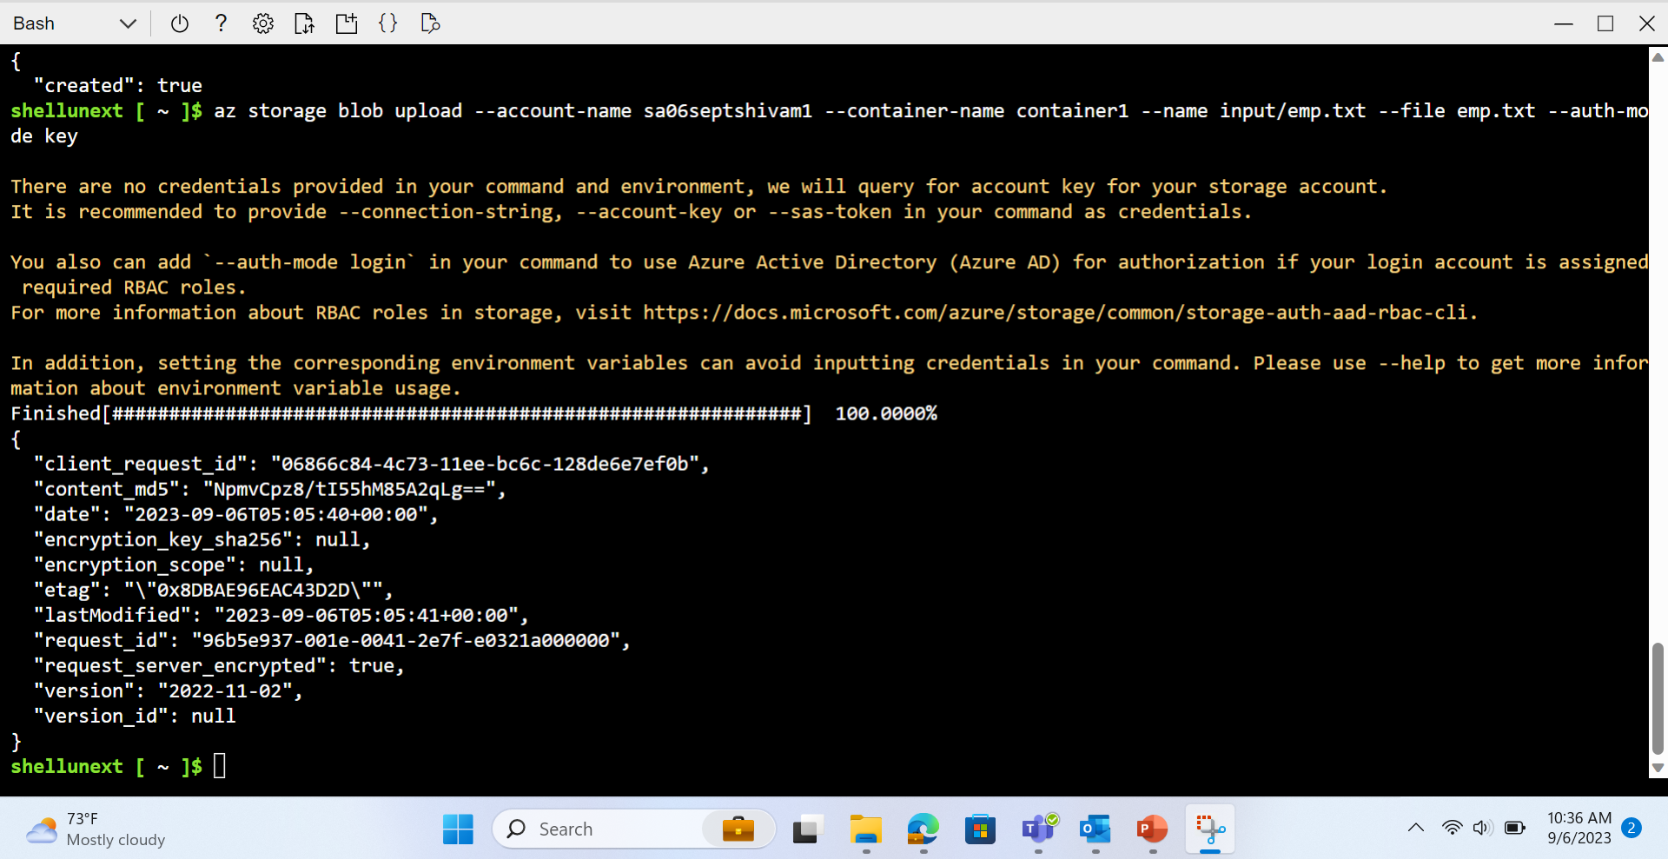
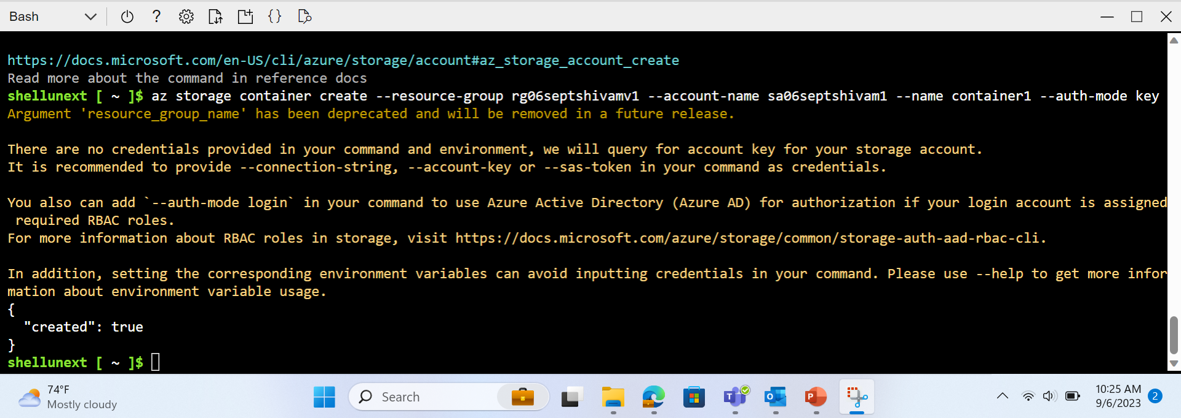

Slide 14
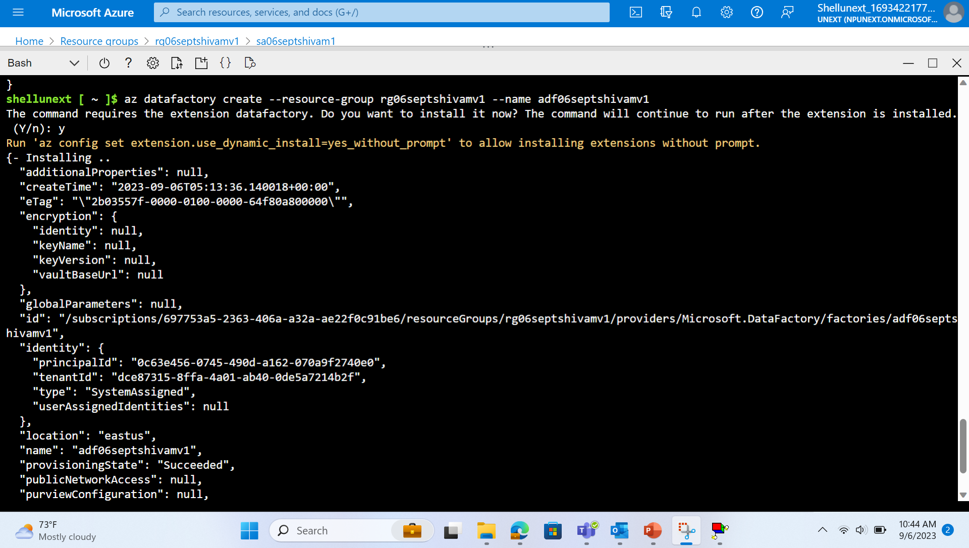
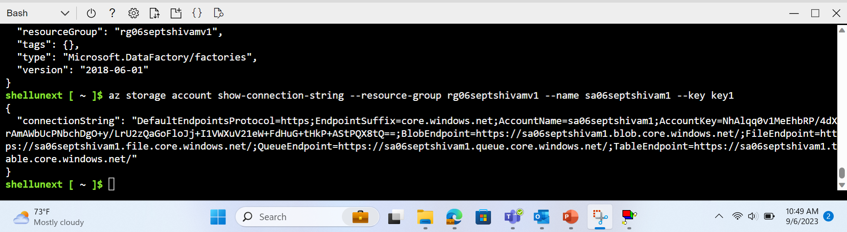

Slide 15
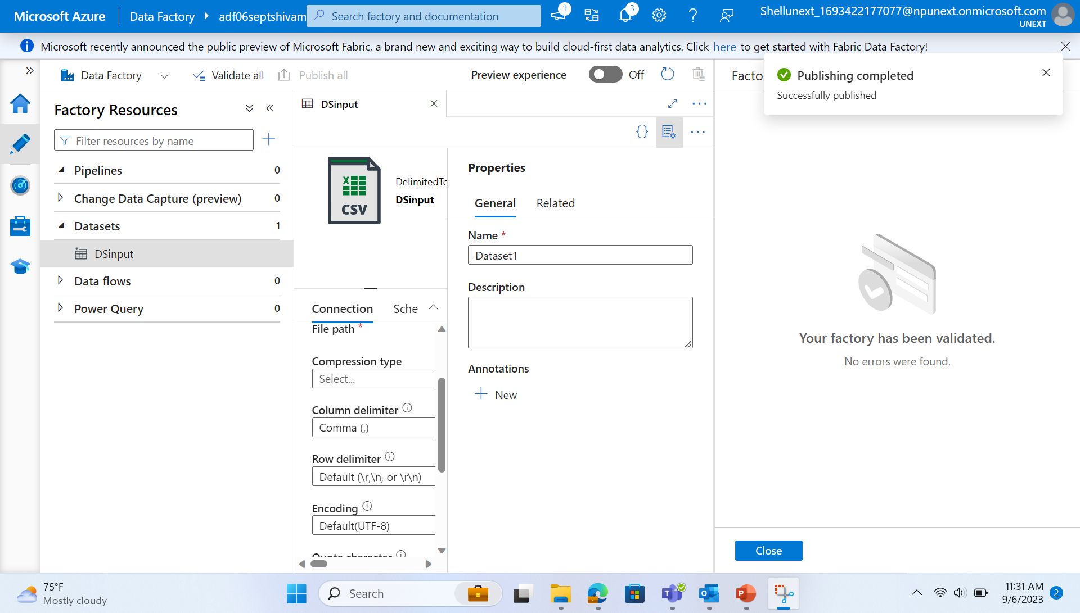
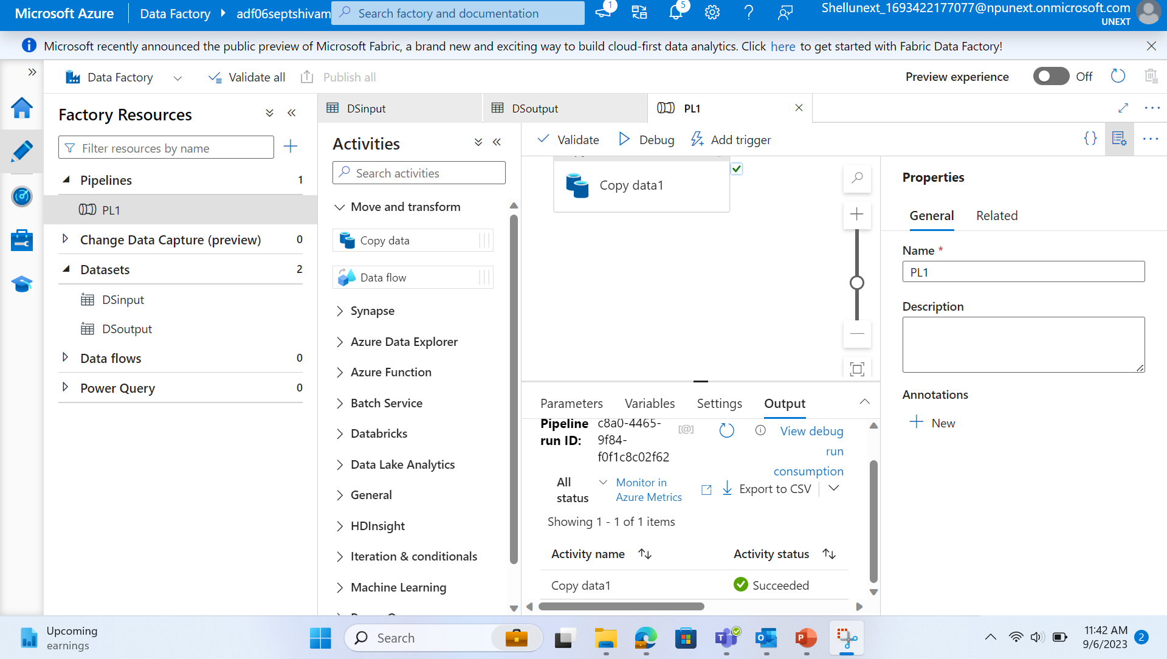
Filtering and Copying of Data by Creating Pipeline

Slide 16
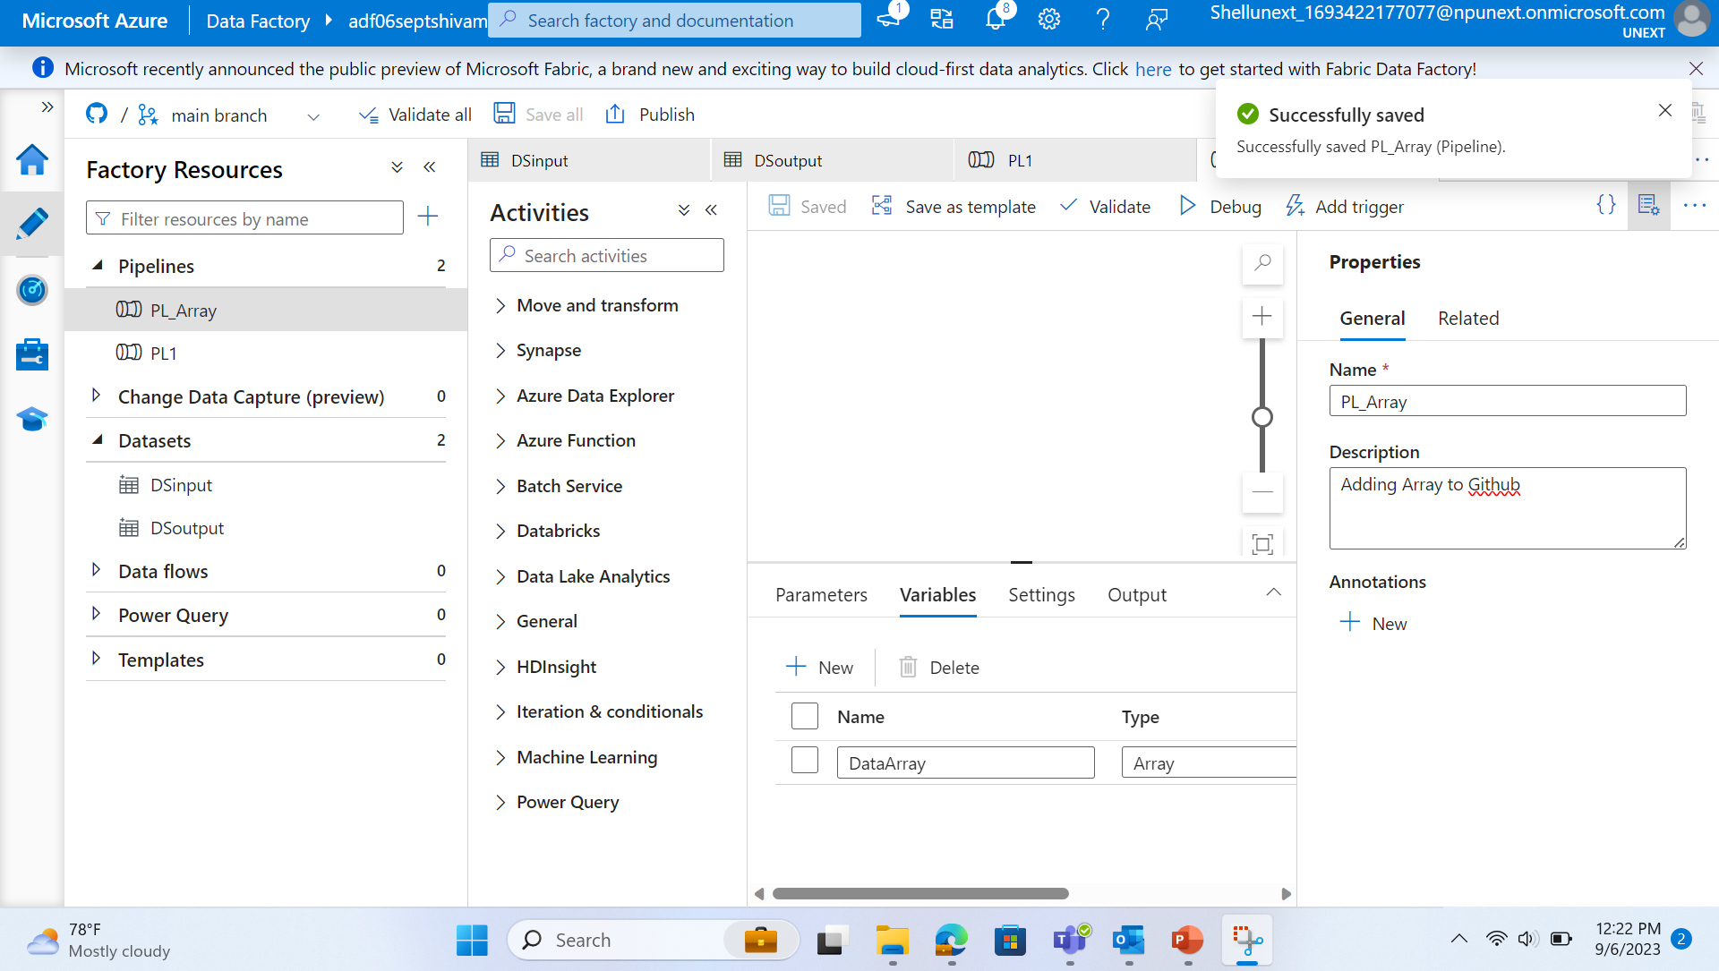
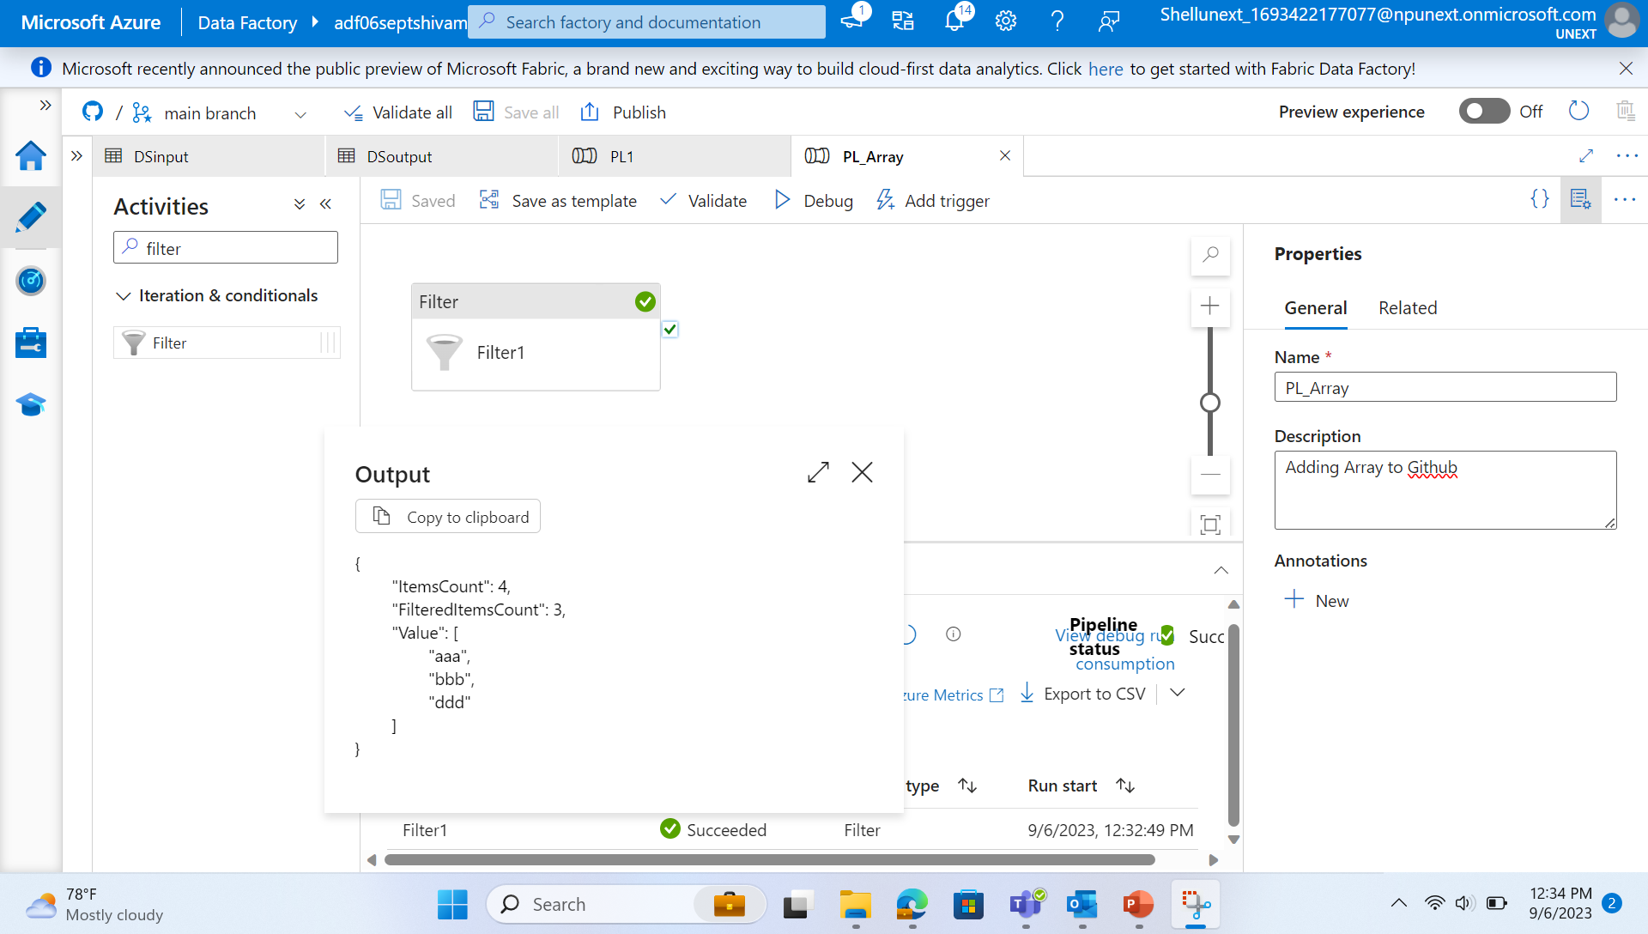
Filtering Data by Creating Pipelines of Arrays and Parameters

Slide 17
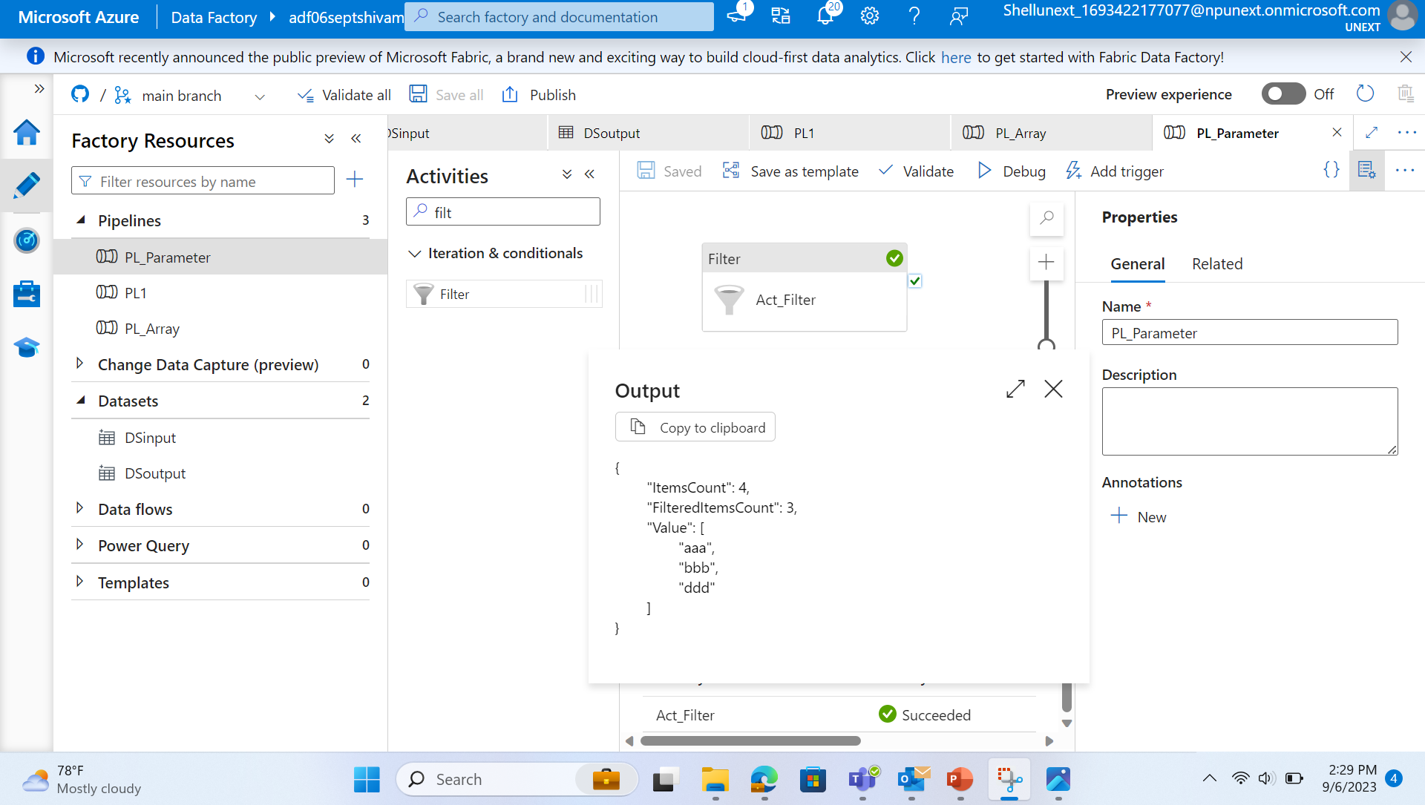
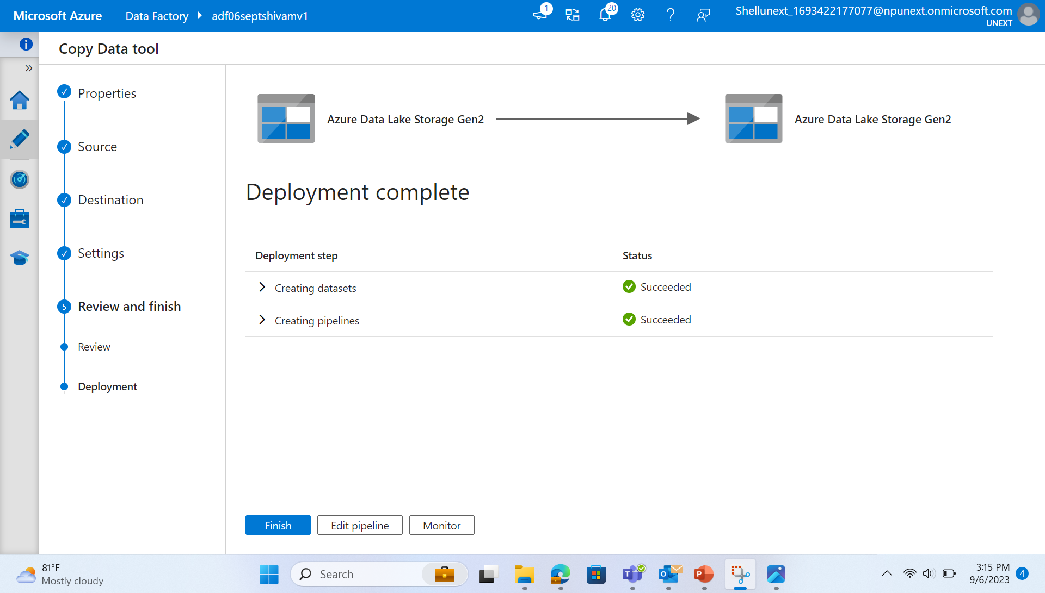

Slide 18
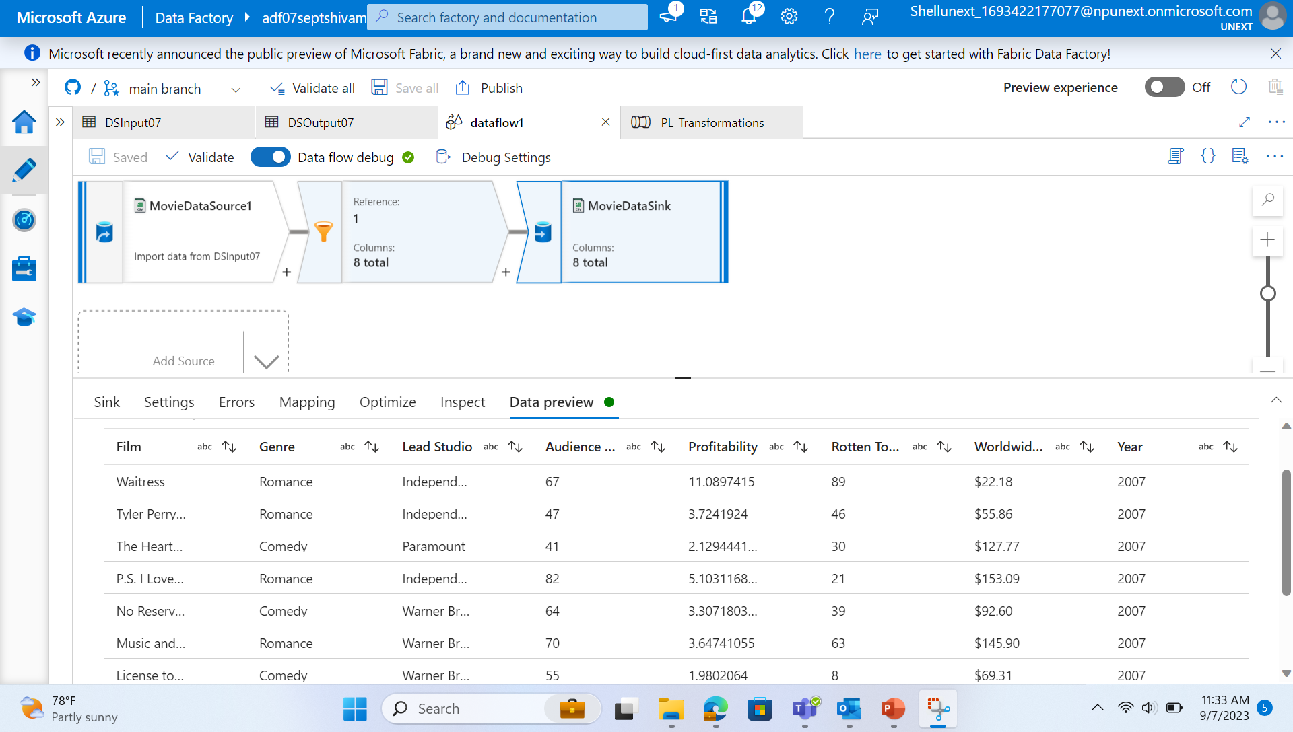
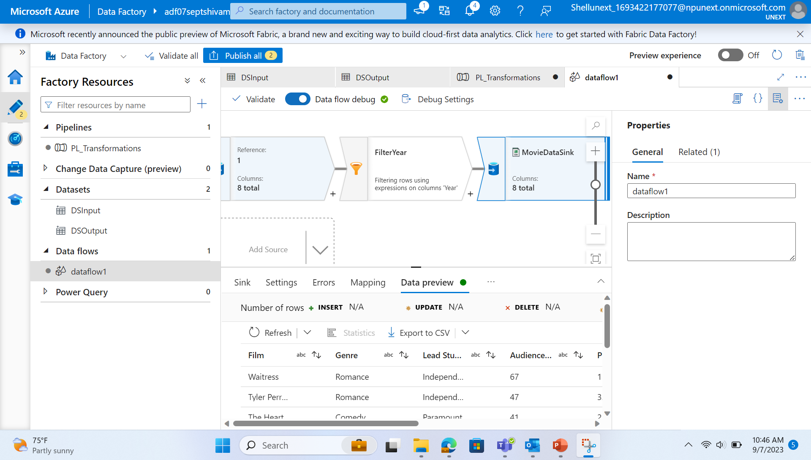
Azure Data Factory
Creating a dataflow and transforming the data by filtering and using various operations.
Creating a pipeline of activities.
Linked Services define the information needed for Azure Data Factory to connect external resources.

Slide 19
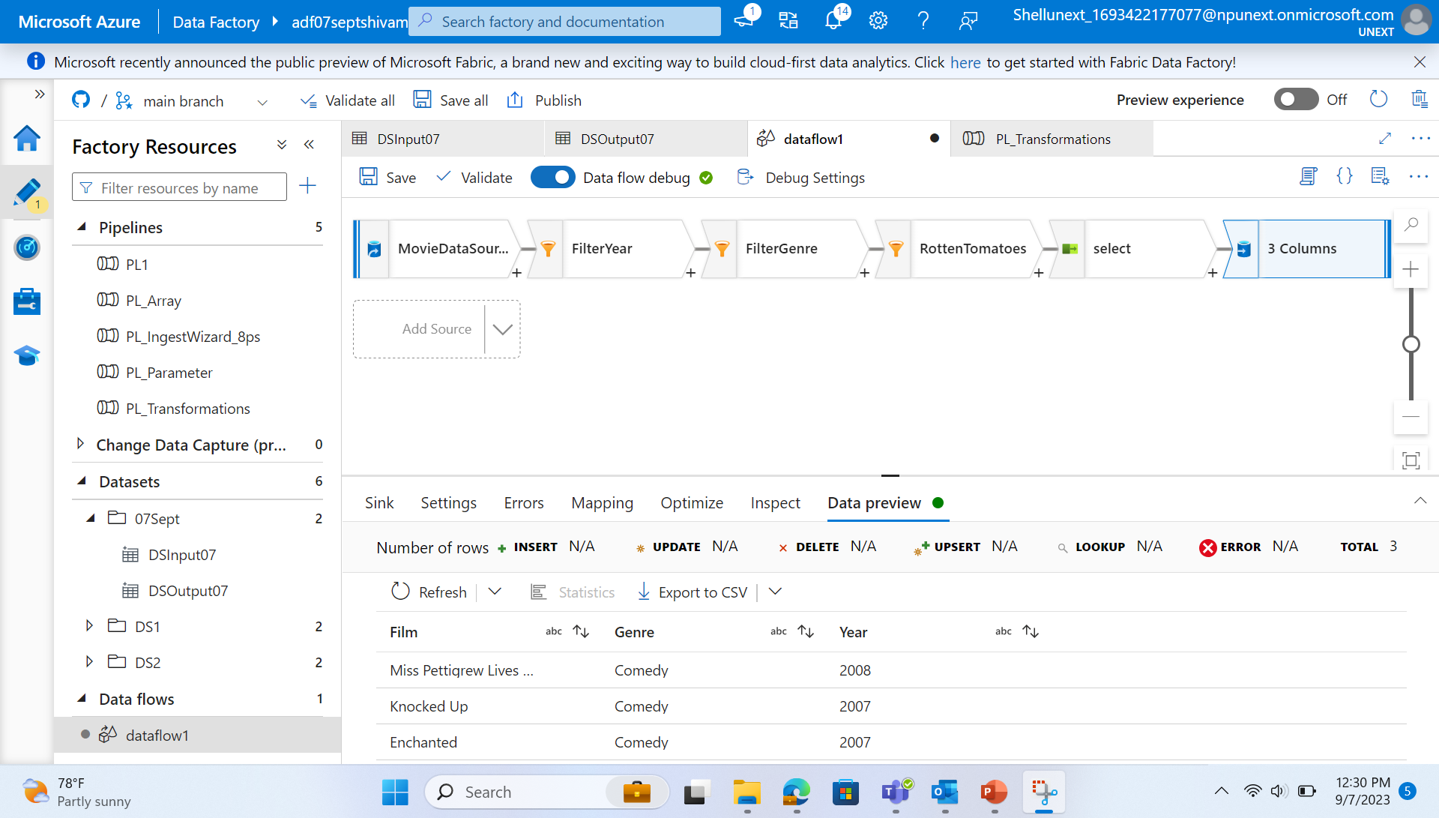
Dataflow

Slide 20
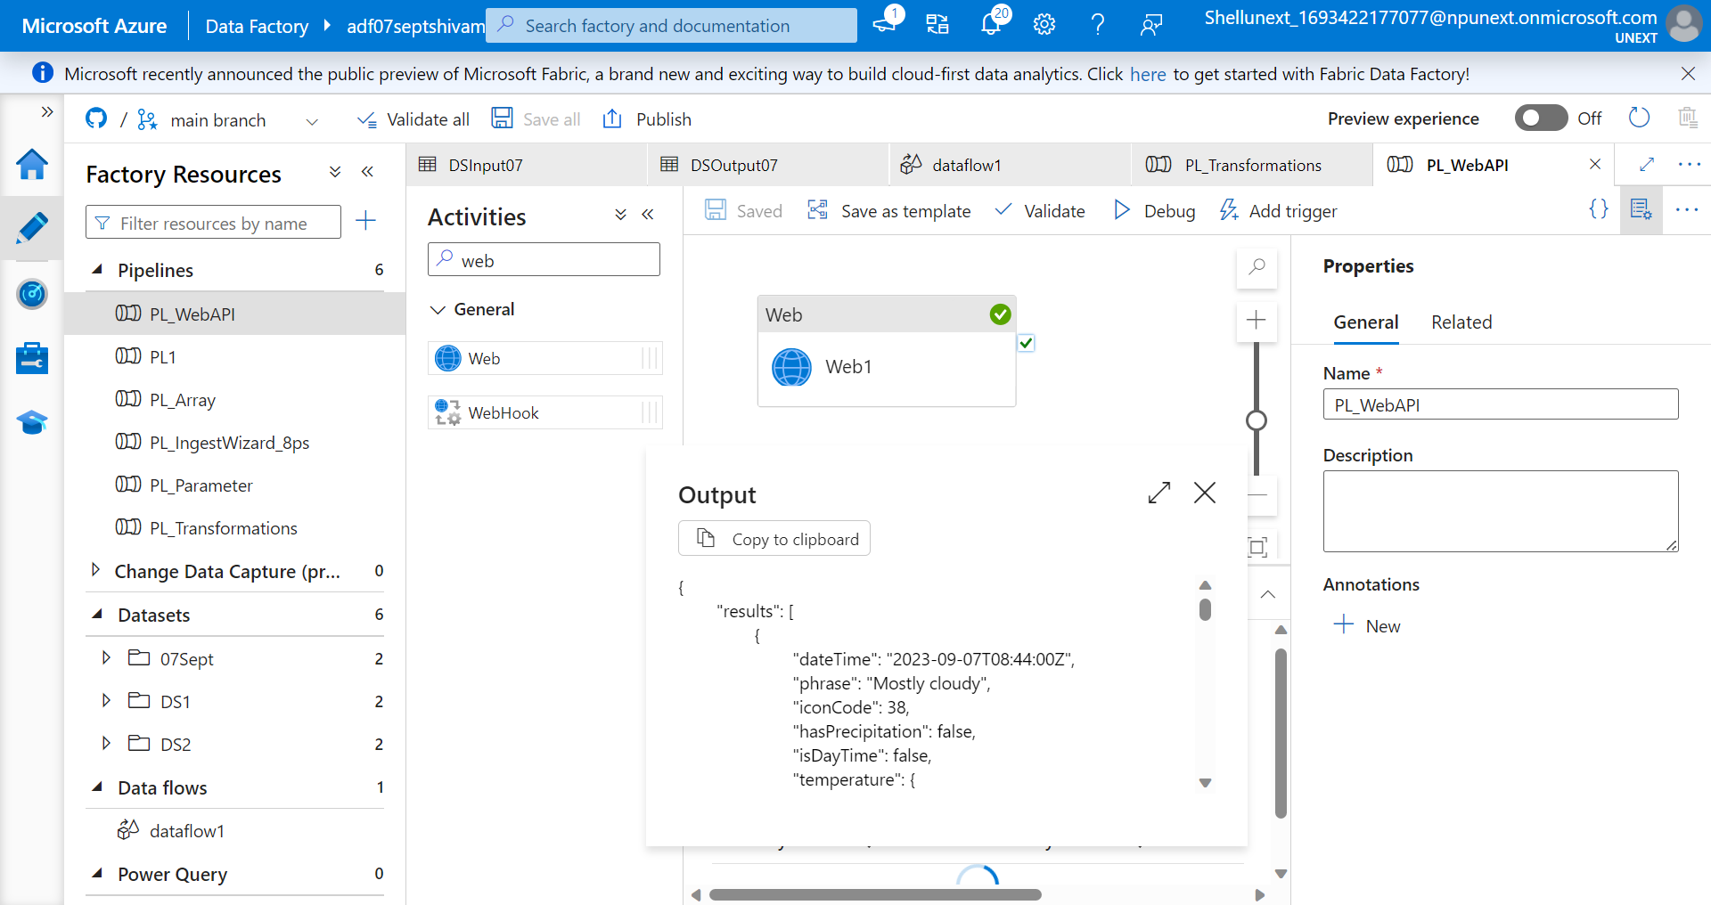
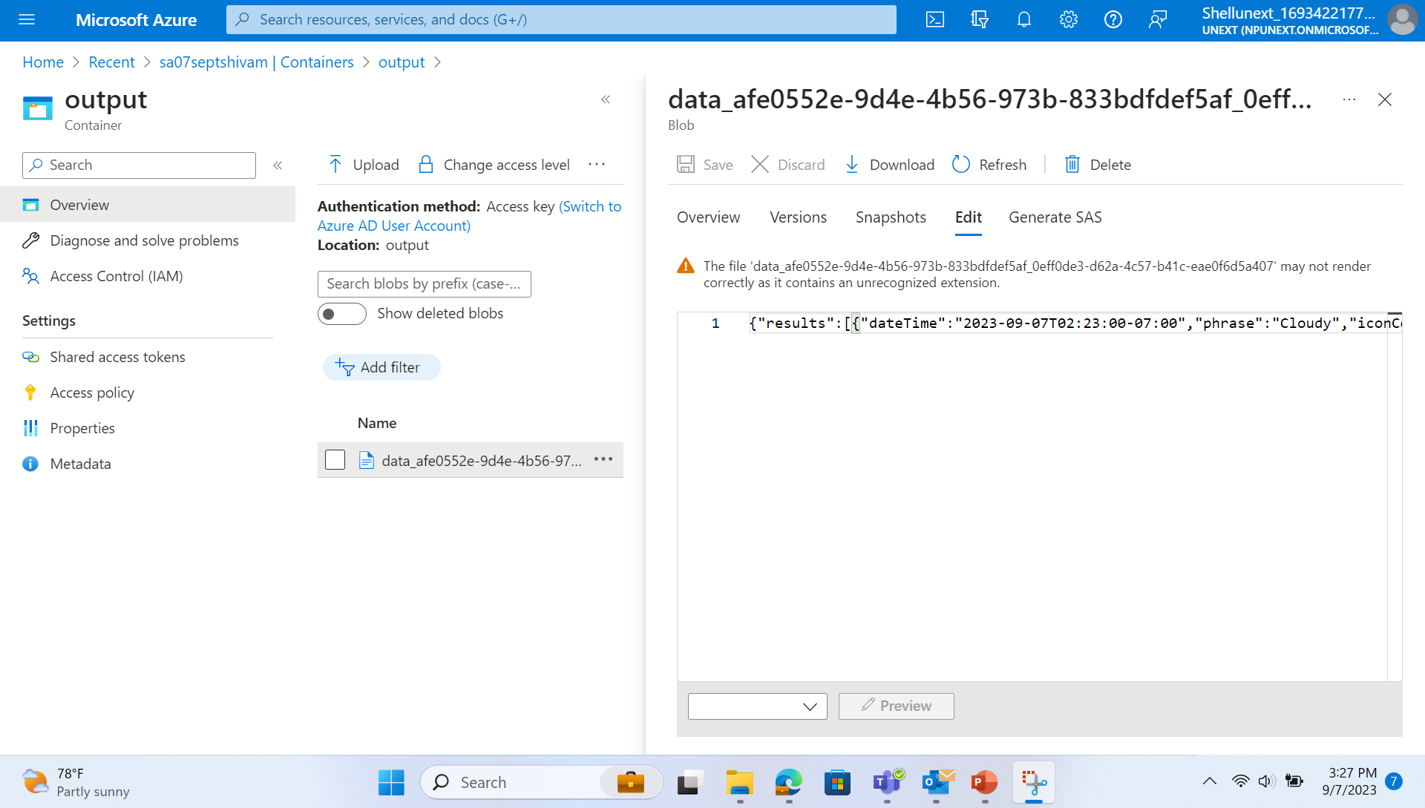
Activity: Storing json file and flattening the data

Slide 21
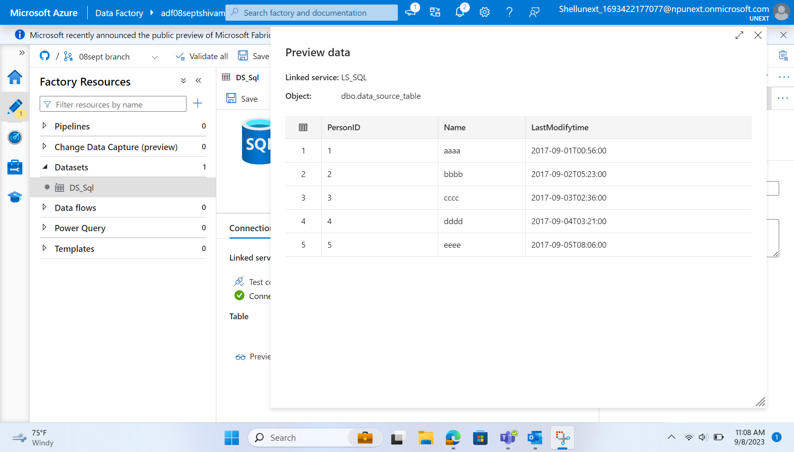
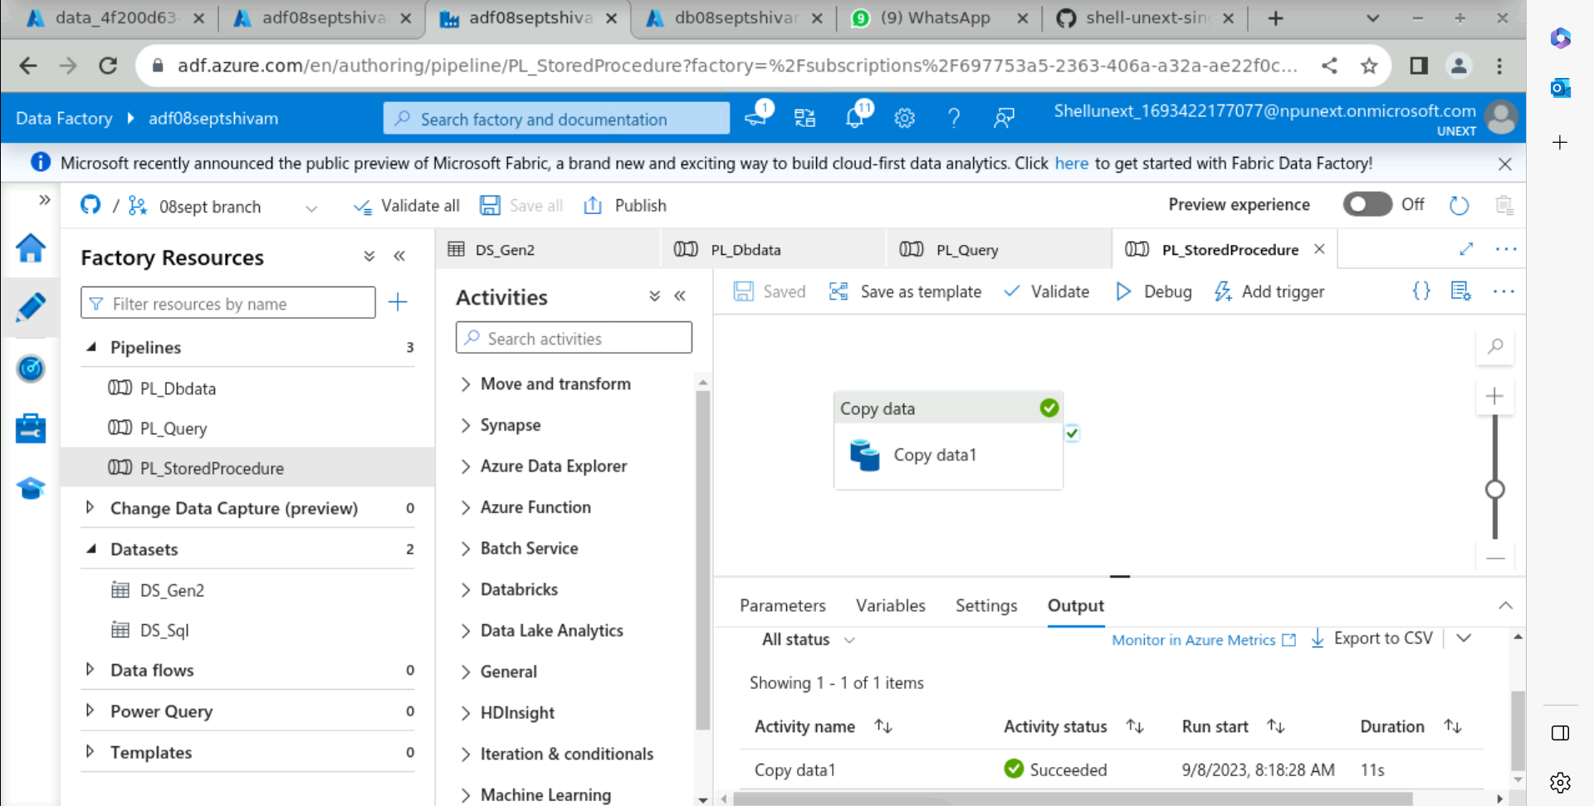
Creating a pipeline by using Lookup Activity and making watermark table to store Last Modified Time and Table Name

Slide 22
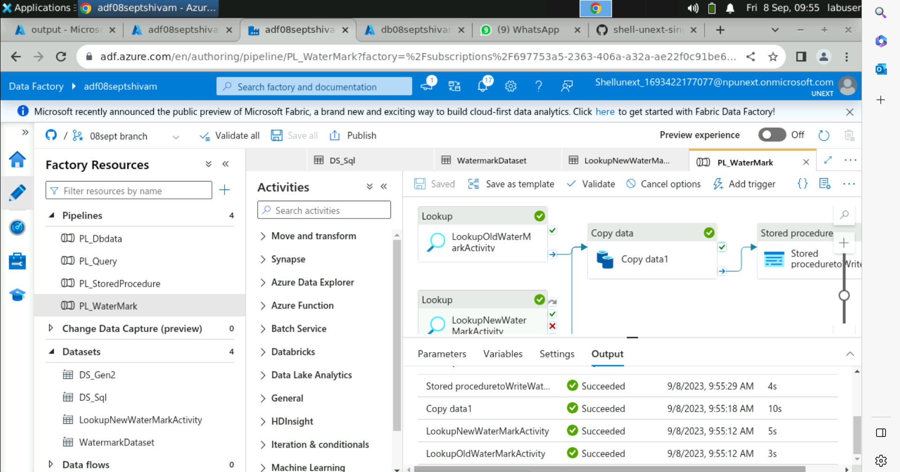
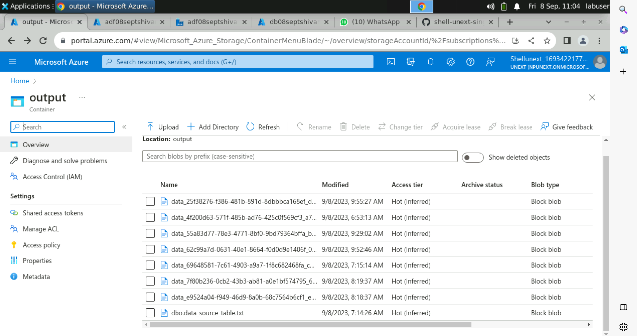
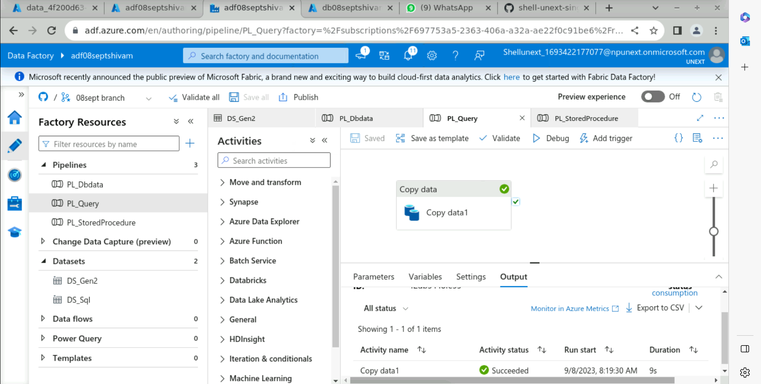
We Created a Azure SQL Database and then copied the data in Storage Account and also made different pipelines with procedures and worked with Lookup Activity.
Data Stored in Container of Storage Account

